Slide 1
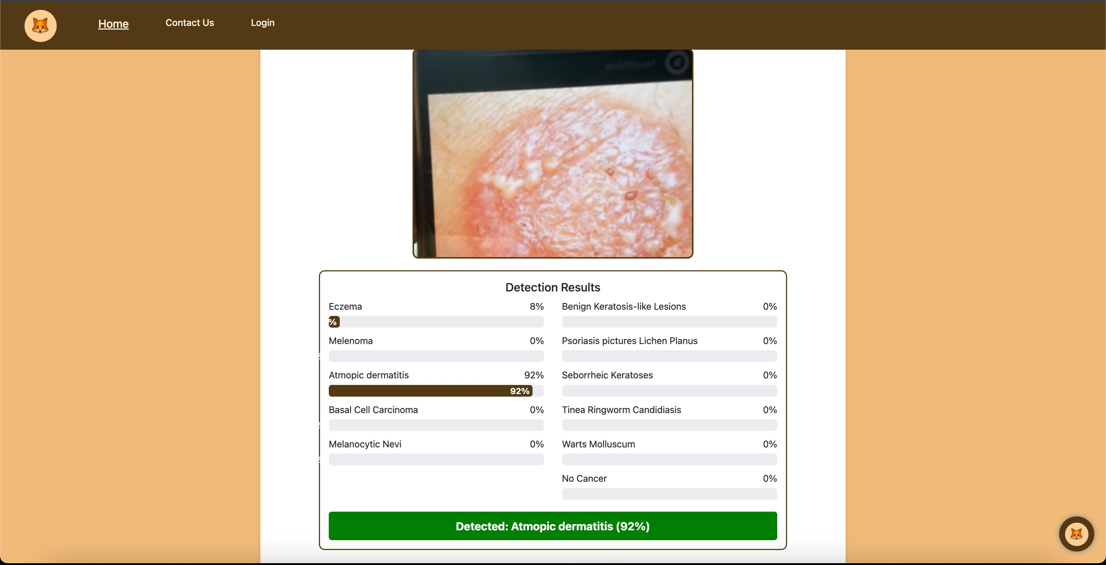
AI-Powered Cancer Detection Chatbox
Our innovative team of four has developed an AI-powered chatbox. It's designed for early cancer detection using modern web technologies. We aim to bridge the gap between technology and accessible healthcare.

Slide 2

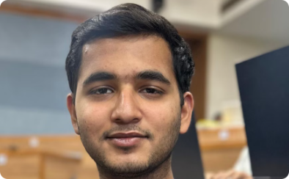
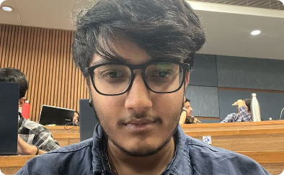
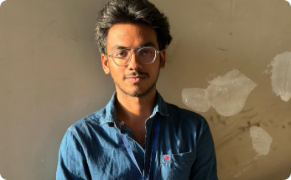
Meet Our Expert Team
Machine Learning Specialist :Darshit
Front-end Development:Alex
AI and Data Training:Aryan
Technical man:Dhruv
Crafts intuitive and responsive user interfaces.
Leads data collection and AI model training efforts.
Provides medical insights and compliance guidance.
Expert in AI algorithms and model optimization.

Slide 3
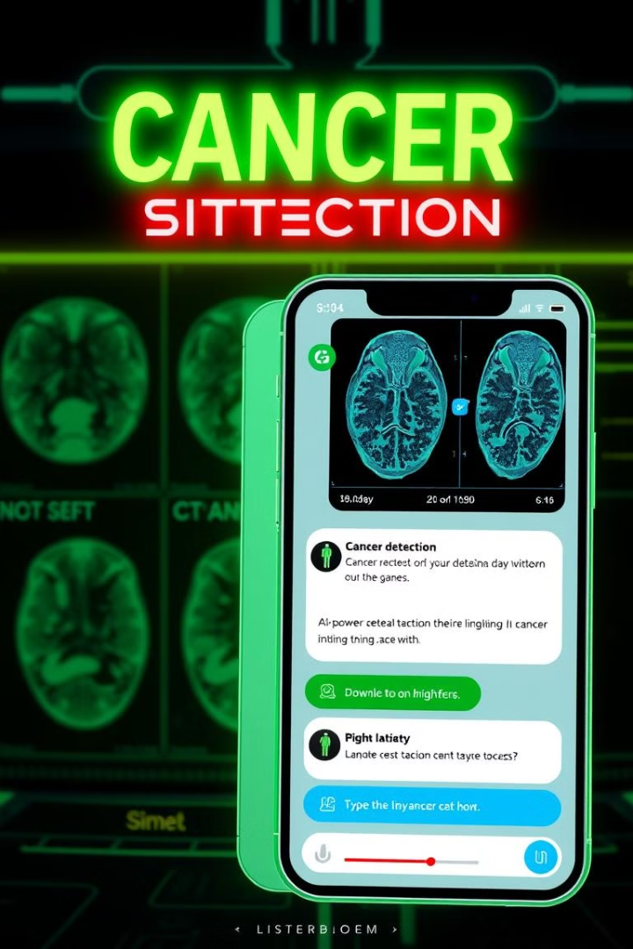



Project Overview
AI-Powered Chatbox
Diagnostic Accuracy
Early cancer detection using machine learning image recognition.
Comparable accuracy to professional diagnostic techniques.
Improved Accessibility
Potential to improve early cancer screening accessibility.

Slide 4




Technical Architecture
HTML5
CSS3
JavaScript
Provides the structure of the chatbox interface.
Ensures responsive and visually appealing design.
Enables interactive and dynamic functionality.
Our project leverages modern web technologies for optimal performance. HTML5, CSS3, and JavaScript are used together to create a seamless user experience.

Slide 5
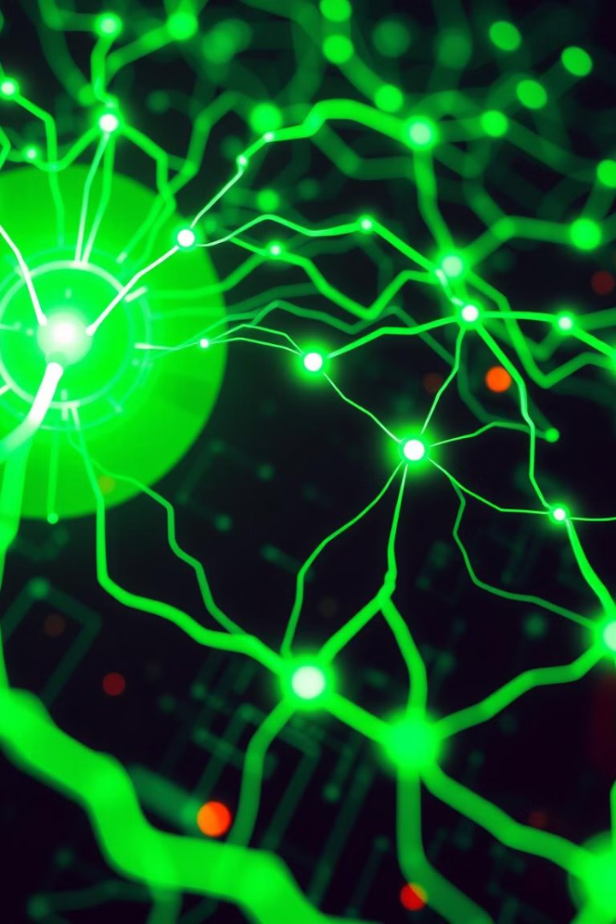




Machine Learning Model
Trained on diverse medical imaging datasets.
Decent accuracy for certain cancers.
Utilizes convolutional neural network (CNN) algorithms.
Analyzes multiple cancer types.

Slide 6

Future Vision and Impact
Democratizing Detection
Reducing Delays
Open-Source Innovation
Accessible cancer detection for everyone.
Faster diagnoses through AI.
Global healthcare advancements.
Our vision is to democratize early cancer detection. By reducing diagnostic delays, we aim to improve patient outcomes. The open-source model encourages global innovation. Continuous learning will enhance the chatbox.

